Slide 1
Models and theories of prescribing decisions: A review and suggested a new model
Ali Murshid M, Mohaidin Z. Models and theories of prescribing decisions: A review and suggested a new model. Pharmacy Practice 2017 Apr-Jun;15(2):990.

Slide 2
Plan
Prescribing Decision
Prescribing Models
Theories relevant to factors influencing prescribing decision
Proposed Model
Suggestions for future research
Conclusion
Ali Murshid M, Mohaidin Z. Models and theories of prescribing decisions: A review and suggested a new model. Pharmacy Practice 2017 Apr-Jun;15(2):990.

Slide 3

Prescribing Decision
The Prescribing Decision is a complex process.
Several factors influence physician decision-making in general practice.
Ali Murshid M, Mohaidin Z. Models and theories of prescribing decisions: A review and suggested a new model. Pharmacy Practice 2017 Apr-Jun;15(2):990.

Slide 4
PRESCRIBING MODELS
Knapp and Oeltjen’s model
The model takes into consideration:
The demographic factors (Age and site of practice)
Severity of disease
Possible decision
Benefits and side effects of medication
Physician’s specialty
Ali Murshid M, Mohaidin Z. Models and theories of prescribing decisions: A review and suggested a new model. Pharmacy Practice 2017 Apr-Jun;15(2):990.

Slide 5
PRESCRIBING MODELS
Hemminki ’s model
Years of practice
Number of work hours
Number of patients administered to daily
Ali Murshid M, Mohaidin Z. Models and theories of prescribing decisions: A review and suggested a new model. Pharmacy Practice 2017 Apr-Jun;15(2):990.

Slide 6
PRESCRIBING MODELS
Raisch’s model (1990)
Direct factors: formularies, prescribing restrictions and required consultations.
Indirect factors: promotions of pharmaceutical firms and visits by medical representatives (MRs), opinions of colleagues, the scientific data derived from randomized, controlled clinical trials and medical training.
Demographics variables of physician and practice factors
Individual and practice factors
Patient factors: patient’s presenting symptoms and doctor’s diagnosis
Psychosocial factors.
Ali Murshid M, Mohaidin Z. Models and theories of prescribing decisions: A review and suggested a new model. Pharmacy Practice 2017 Apr-Jun;15(2):990.

Slide 7
PRESCRIBING MODELS
Gallan’s model (2005)
Marketing efforts
Economic factors
Government factors
Ali Murshid M, Mohaidin Z. Models and theories of prescribing decisions: A review and suggested a new model. Pharmacy Practice 2017 Apr-Jun;15(2):990.

Slide 8
PRESCRIBING MODELS
Singh’s model (2008)
Relationship Strength between physician and medical representatives
Promotional activities
Detailing
Ali Murshid M, Mohaidin Z. Models and theories of prescribing decisions: A review and suggested a new model. Pharmacy Practice 2017 Apr-Jun;15(2):990.

Slide 9
PRESCRIBING MODELS
Kyle, Nissen and Tett’s model (2008)
Economic factors
Direct and indirect commercial impacts on physician prescribing decision.
Ali Murshid M, Mohaidin Z. Models and theories of prescribing decisions: A review and suggested a new model. Pharmacy Practice 2017 Apr-Jun;15(2):990.

Slide 10
PRESCRIBING MODELS
Godin et al.’s model (2008)
The past Behavior (Habit)
Non-psychological factors
Ali Murshid M, Mohaidin Z. Models and theories of prescribing decisions: A review and suggested a new model. Pharmacy Practice 2017 Apr-Jun;15(2):990.

Slide 11
PRESCRIBING MODELS
Stros and Lee’s model (2015)
Marketing Mix “4P”;
Place
Price
Promotion
Product
Market environment
Physician
Ali Murshid M, Mohaidin Z. Models and theories of prescribing decisions: A review and suggested a new model. Pharmacy Practice 2017 Apr-Jun;15(2):990.

Slide 12
Theories relevant to factors influencing prescribing decision
Agency theory
Theory of persuasion
The buyer behavior – stimulus-response theory
Theory of planned behavior
Theory of social power
Ali Murshid M, Mohaidin Z. Models and theories of prescribing decisions: A review and suggested a new model. Pharmacy Practice 2017 Apr-Jun;15(2):990.

Slide 13
Agency theory
Focus on two critical agency relationships;
The physician (agent) and patient (principal)
The pharmaceutical firm (principal) and physician (agent)
Ali Murshid M, Mohaidin Z. Models and theories of prescribing decisions: A review and suggested a new model. Pharmacy Practice 2017 Apr-Jun;15(2):990.

Slide 14
Agency theory
Pharmaceutical firm (principal)
Passionate about selling their products and making a profit.
Provide a limited amount of information available
Believed in its products (drugs) and being at arm’s length from the patient.
its success is influenced by environmental factors (i.e. Habit persistence and drug cost/benefit ratio).
Ali Murshid M, Mohaidin Z. Models and theories of prescribing decisions: A review and suggested a new model. Pharmacy Practice 2017 Apr-Jun;15(2):990.

Slide 15
Agency theory
Patient (Principal)
Interested in the most effective, practical, least invasive and cost effective treatment.
May know something about his condition, but does not understand the effectiveness of the prescription alternatives, and why physician chooses this medication.
The physician’s prescription is a function of many variables that the patient does not control much (e.g., drug characteristics, drug cost/benefit ratio, habit persistence).
Ali Murshid M, Mohaidin Z. Models and theories of prescribing decisions: A review and suggested a new model. Pharmacy Practice 2017 Apr-Jun;15(2):990.

Slide 16
Theory of persuasion
Exchange between the Sender and Receiver
Sender of information
Receiver
Modification in behavior
Ali Murshid M, Mohaidin Z. Models and theories of prescribing decisions: A review and suggested a new model. Pharmacy Practice 2017 Apr-Jun;15(2):990.

Slide 17
Theory of persuasion
Elaboration Likelihood Model (ELM) is the most widely used model in the context of persuasion theory.
The model proposes that individuals use both cognitive abilities and emotional reaction to interpret data and make decisions.
ELM model is composed of two methods of persuasion:
The focal method comprises a high level of planning and cognitive effort
The peripheral method includes a lower level of cognitive efforts
Ali Murshid M, Mohaidin Z. Models and theories of prescribing decisions: A review and suggested a new model. Pharmacy Practice 2017 Apr-Jun;15(2):990.

Slide 18
Theory of persuasion
Doctors may be affected in the same way as any highly engaged consumer who can absorb information and then perform comprehensive cognitive therapy, an approach described by the ELM model
Effects include:
Environmental effect (Patient and Pharmacist)
Personal Relationships with medical representative and pharmacist
Marketing effect (drug information, branding and promotional tools)
Physician characteristics (Habit persistence)
Drug characteristics
Emotionally impact on the decision-making of physicians during prescribing.
Ali Murshid M, Mohaidin Z. Models and theories of prescribing decisions: A review and suggested a new model. Pharmacy Practice 2017 Apr-Jun;15(2):990.

Slide 19
The buyer behavior – stimulus-response theory
The original information deduced from this model is the process of the buyer’s (physician) consciousness from external stimuli to the purchase (prescribing) decision.
The characteristics of the purchaser (doctor) can be attributed to private variables such as social and psychological factors.
The decision-making process of the buyer (physician) will ultimately define what, if any, buy (prescriptions) behavior occurs
Ali Murshid M, Mohaidin Z. Models and theories of prescribing decisions: A review and suggested a new model. Pharmacy Practice 2017 Apr-Jun;15(2):990.

Slide 20
Theory of planned behaviour
The TPB theory is one of the most appropriate and frequently considered behavioral theory when attempting to modify or influence physician prescribing.
TBP demonstrated a high predictability of physician behavior in the healthcare context.
TBP has proven to be a successful analytical tool for dealing with factors that influence prescribing behavior. This factors include:
Ali Murshid M, Mohaidin Z. Models and theories of prescribing decisions: A review and suggested a new model. Pharmacy Practice 2017 Apr-Jun;15(2):990.

Slide 21
Theory of social power
Social power is defined as the ability of a person/ individual or group of individuals to alter the outlook or behavior of someone else or panel in conformity with the course anticipated by the persuasion.
The theory of social power is applied to better understand the role of the expertise of pharmacists in prescribing drugs.
Doctors may have little knowledge when it comes to the decision to prescribe a new drug (doctors voluntarily adhere to pharmacists ’recommendations because of their expert strength)
Ali Murshid M, Mohaidin Z. Models and theories of prescribing decisions: A review and suggested a new model. Pharmacy Practice 2017 Apr-Jun;15(2):990.

Slide 22

Proposed model
The novel model includes
Marketing efforts
Patient characteristics and pharmacist factors
Contextual factors
Confidence in the relationship between physicians and pharmacists
Ali Murshid M, Mohaidin Z. Models and theories of prescribing decisions: A review and suggested a new model. Pharmacy Practice 2017 Apr-Jun;15(2):990.

Slide 23
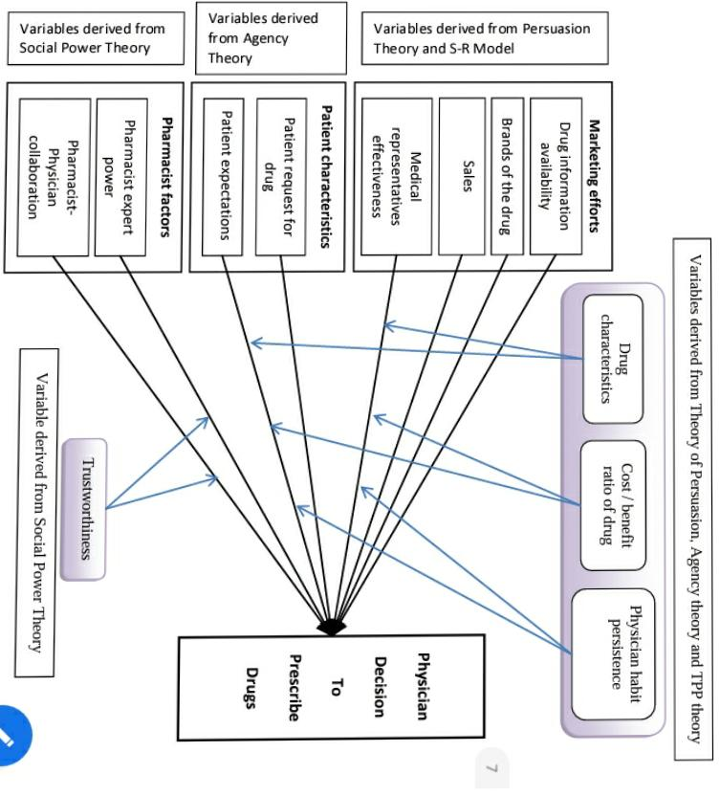
Proposed Model
Proposed Model

Slide 24

Managerial implications of proposed model
Pharmaceutical marketers can design their marketing strategies to improve the marketing of pharmaceutical products and measure the effects of their current activities on prescription rates.
Expected results from this model may enable managers to identify attitudes and investments that are likely to influence the physician's prescription behavior's of physicians.
Ali Murshid M, Mohaidin Z. Models and theories of prescribing decisions: A review and suggested a new model. Pharmacy Practice 2017 Apr-Jun;15(2):990.

Slide 25
Suggestions for future research
Identify effective tool for providing information to physicians.
Examine variables that may determine the relationship between marketing efforts and physicians’ decision making
Improving patient characteristics that influence prescribing decision
Examine the influence of pharmacist on prescribing decision
Ali Murshid M, Mohaidin Z. Models and theories of prescribing decisions: A review and suggested a new model. Pharmacy Practice 2017 Apr-Jun;15(2):990.

Slide 26
Conclusion
The proposed model suggests possible relationships between several basic variables related to prescribing decision:
Marketing strategies
Patient characteristics
Contextual factors
Physician perception of pharmacist collaboration, expert power and trustworthiness
Drug characteristics
Physician habit persistence.
Ali Murshid M, Mohaidin Z. Models and theories of prescribing decisions: A review and suggested a new model. Pharmacy Practice 2017 Apr-Jun;15(2):990.

